Slide 1
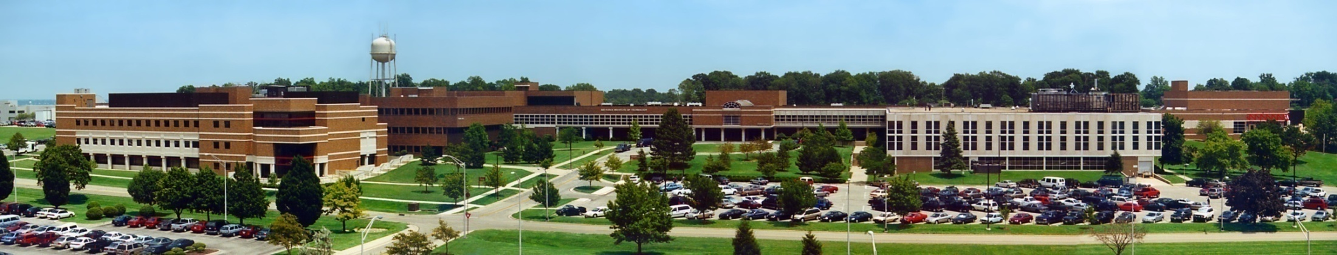
Intro To Python
Air Force Institute of Technology
Scott Nykl, PhD Tutorials referenced from www.learnpython.org

Slide 2
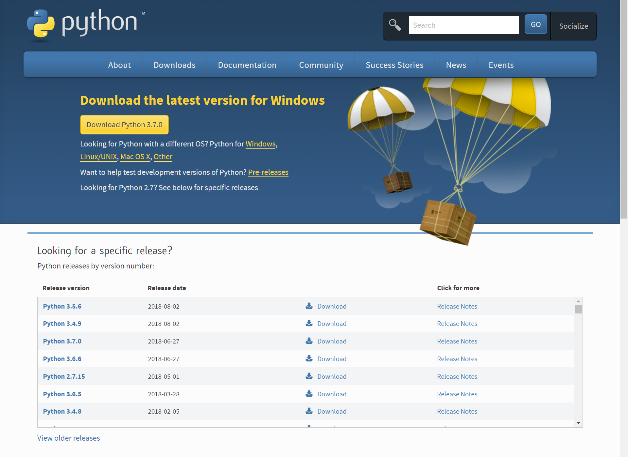
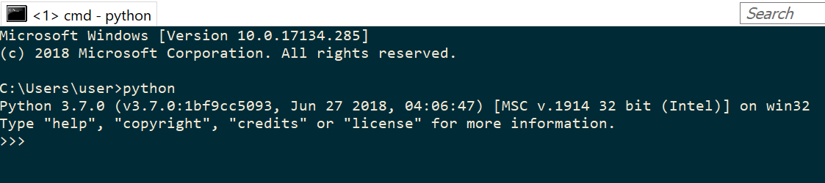
Install
Install Python 3.5
Add to PATH
Open CMD Window:
Linux: sudo apt-get install python3

Slide 3
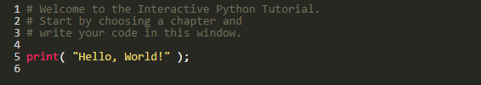

Hello World
Can run from CMD Line
“Run code live”

